Slide 1

Introduction to Artificial Intelligence Group 1 Week 3
Dr. Juan Carlos Rojas
Juan-Carlos.Rojas@ttu.edu

Slide 2
Schedule
Date | Class | HW Assigned | HW Due
May 18 | Class 1 | HW1
May 25 | Class 2 | HW2 | HW1
June 1 | Class 3 | HW3 | HW2
June 8 | Class 4 | HW4 | HW3
June 15 | No class
June 22 | Class 5 | HW5 | HW4
June 29 | Class 6 | HW6 | HW5
July 6 | Class 7 | HW7 | HW6
July 13 | Class 8 |  | HW7

Slide 3
Agenda for Week 3
Theory
Binary Classification
Quality metrics
Classification with linear regression
Logistic regression
Support vector machines
K-nearest neighbors
Decision trees
Random forests
Ensemble methods
Practice
Credit default dataset
Feature exploration
Pre-processing
Linear regression
Logistic regression
SVM
kNN
Decision tree
Random forest
Ensemble

Slide 4
Classification

Slide 5
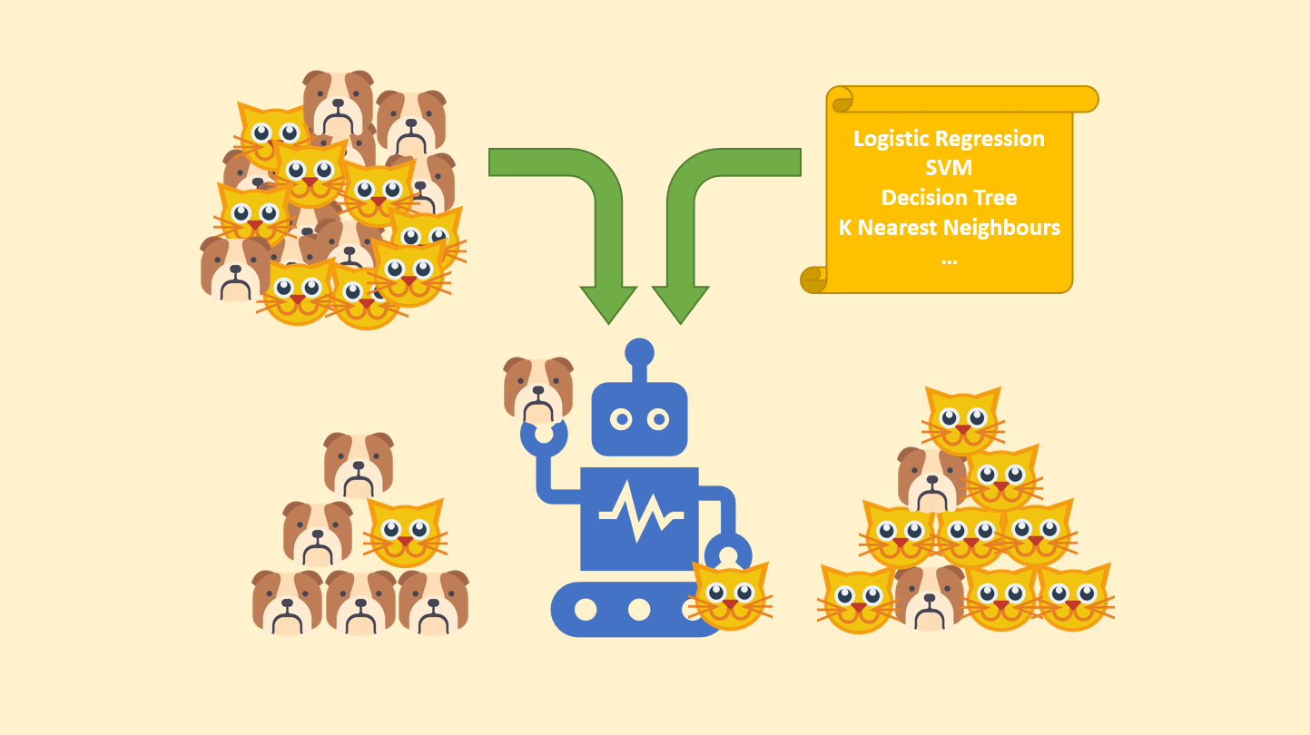
Binary Classification
Organize into two buckets

Slide 6
Credit Default Database
Database of credit card default situations in Taiwan in 2005
Based of https://archive.ics.uci.edu/ml/datasets/default+of+credit+card+clients
Cleaned-up by JCR
Replaced numbers by labels in categorical columns (education, marriage, etc.)
Removed derived columns
Changed some column names
16 input features
Age, education, marriage, sex
Credit limit
Current bill
Last 5 bill amounts
Last 5 payments
Binary output feature
Will default on payment next month? (1/0)
30,000 cases

Slide 7
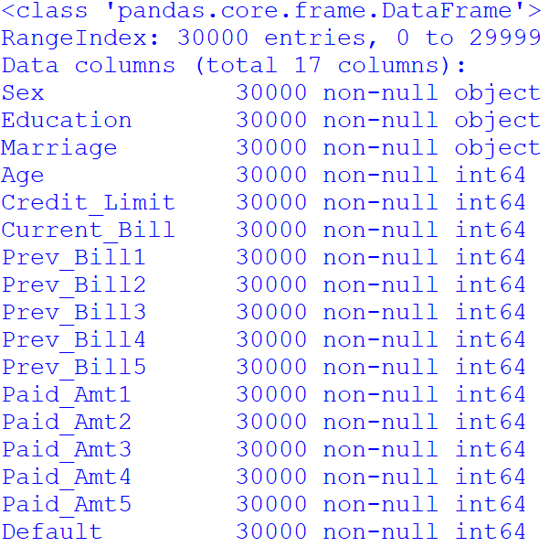
Explore the Data
See CreditDefault_ExploreFeatures_1.py

Slide 8
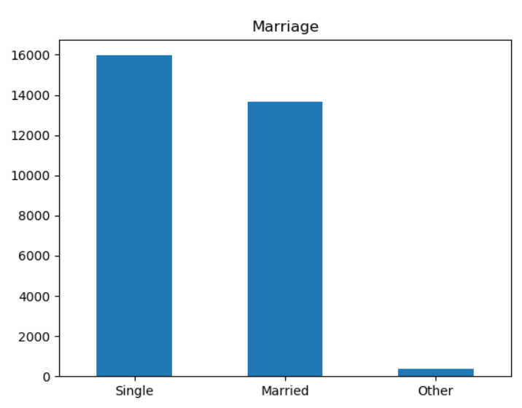
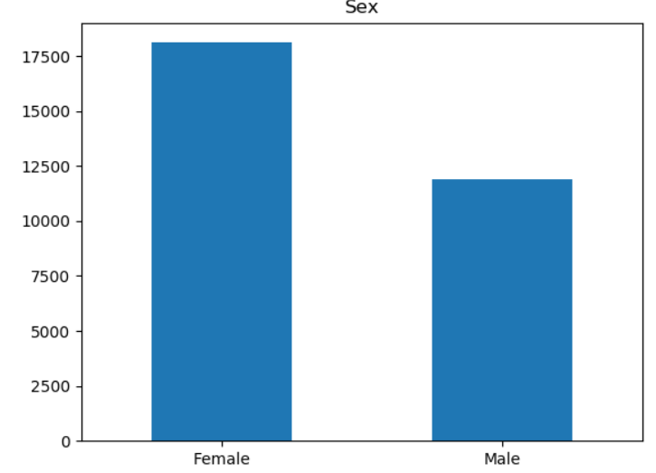
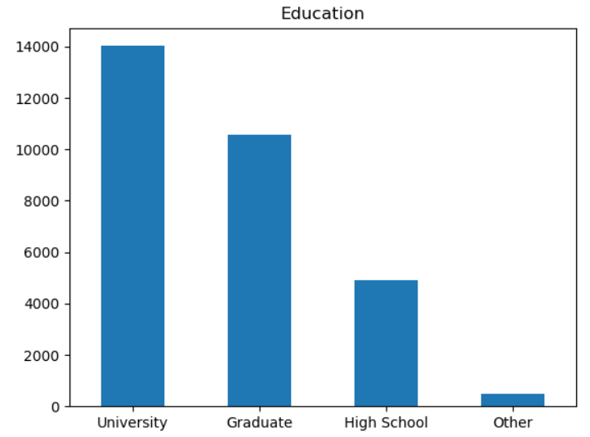
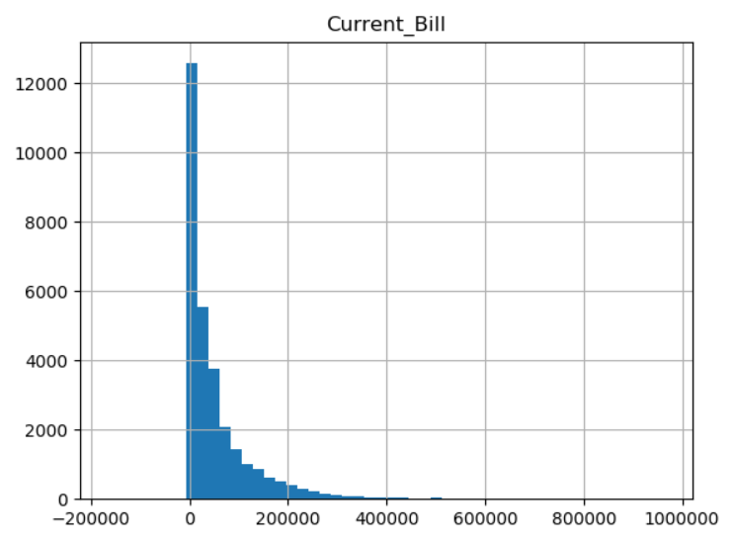
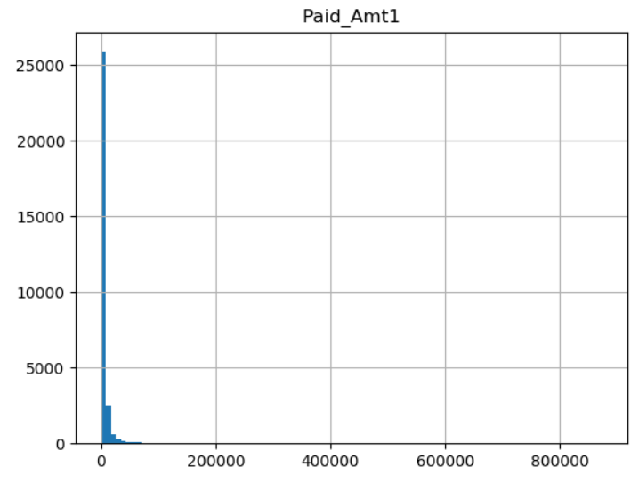
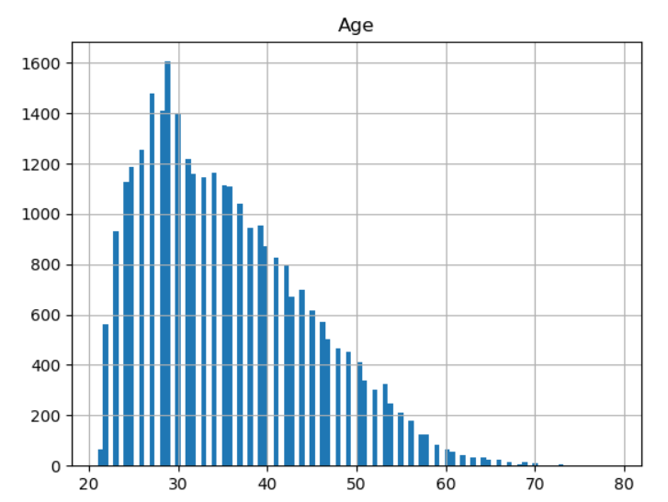
Input Data Distributions
See CreditDefault_ExploreFeatures_1.py

Slide 9
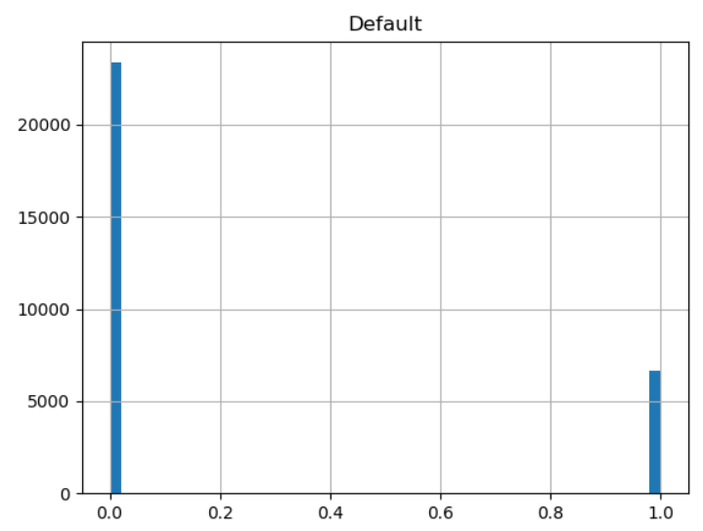
Output Data Distribution
The output labels are class-imbalanced
Need to be careful when configuring models and analyzing results

Slide 10
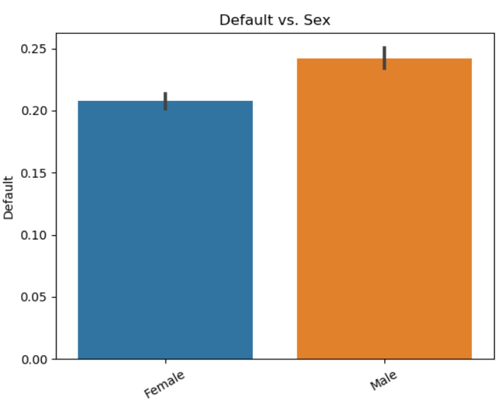
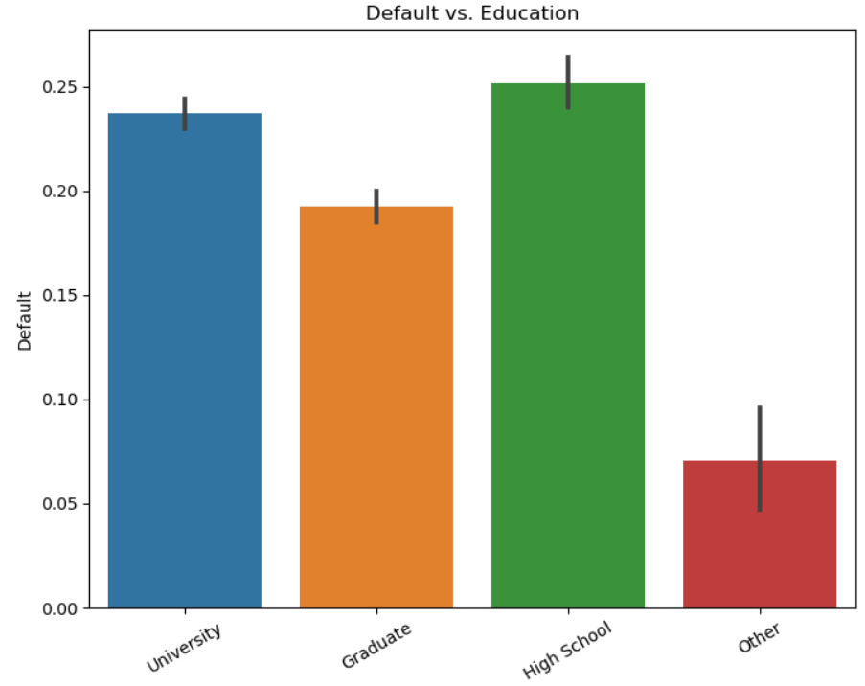
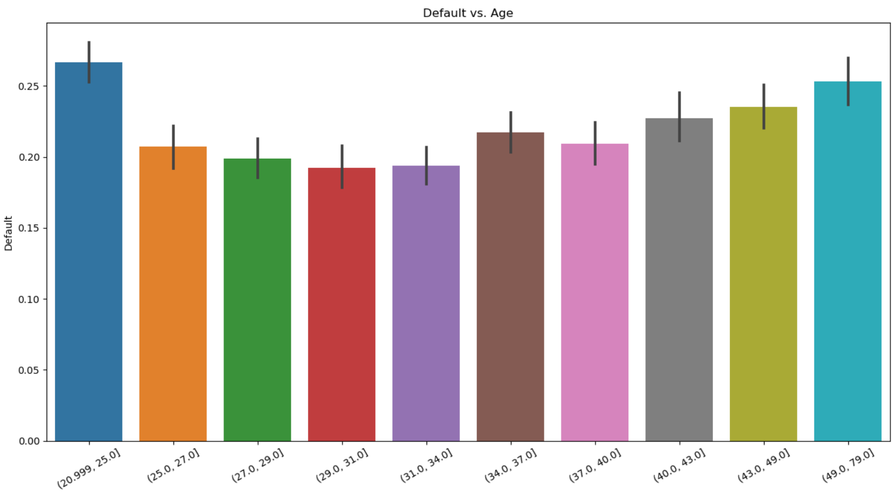
Individual Feature Relationships to Output
Since the output feature is categorical, bar-plots make more sense
Default rate by category
This is very easy with Seaborn bar-plots
See CreditDefault_ExploreFeatures_2.py

Slide 11
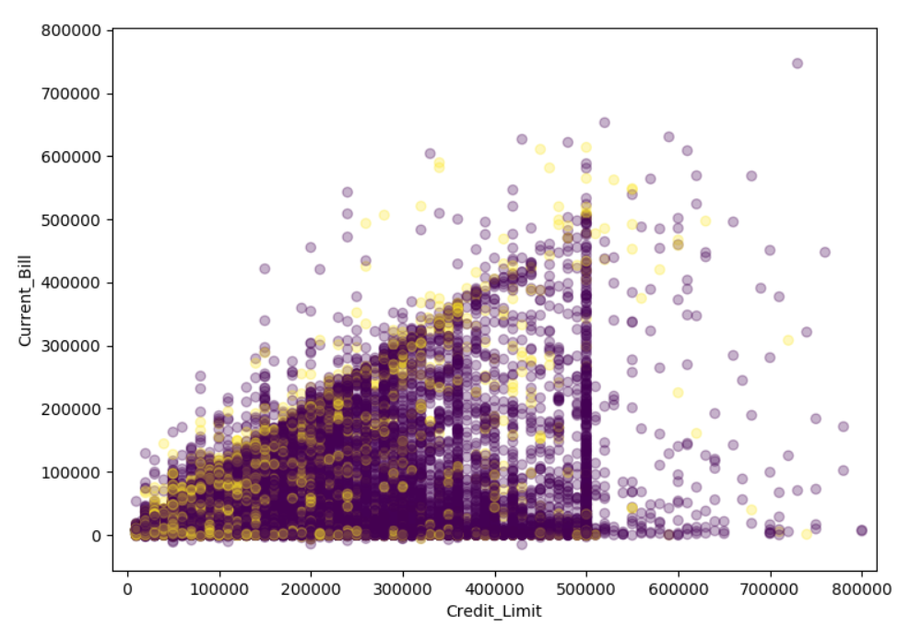
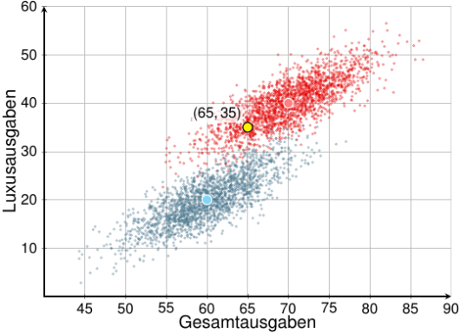
Cluster-Maps
A scatterplot with color-coded markers according to class
Lets us explore two variables at a time
We look for class separation
No clear separation in this case
<- Ideal case
See CreditDefault_ExploreFeatures_3.py

Slide 12
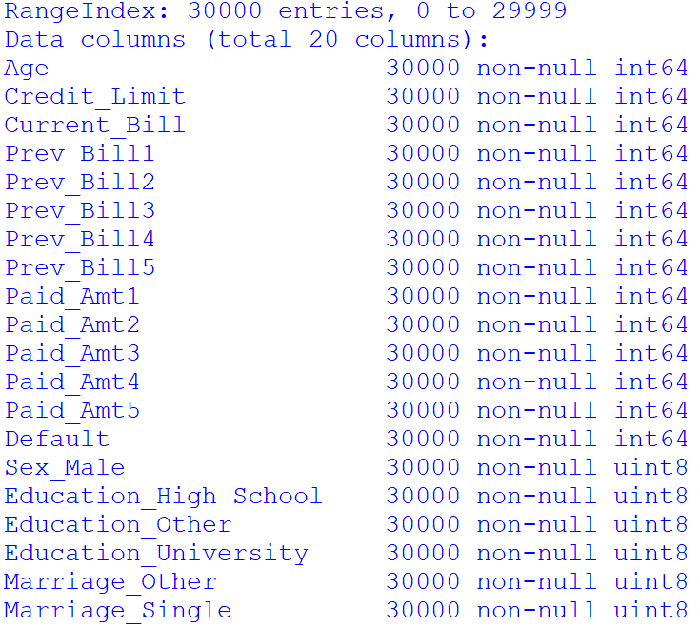
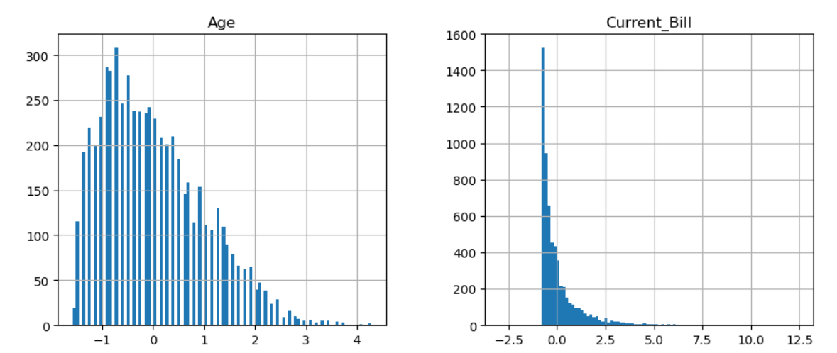
Pre-Process
As usual, we need to:
Encode categorical features
Shuffle the data
Split into training and test
Separate input features from output labels
Standardize the scale
Save
See CreditDefault_PrepareDataset.py

Slide 13
Classification with Linear Regression
We can train a linear regressor for the credit default, as before
This will produce a prediction number that is continuous between 0 and 1
It can be interpreted as a prediction probability of being a credit default

Slide 14
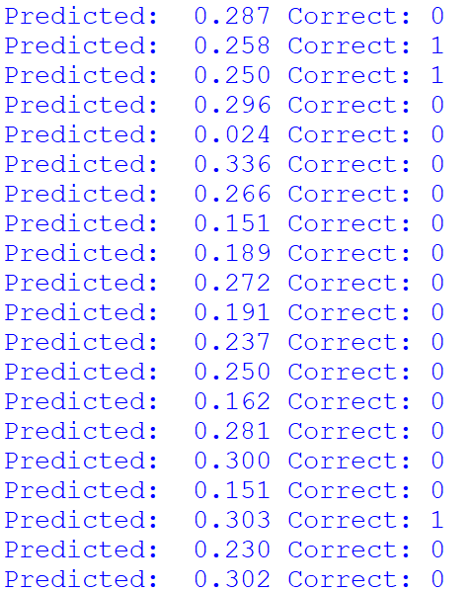
Practice 1
Load the credit default dataset pickle file (credit_card_default_dataset.pickle)
Train a linear prediction model against all the available features
Predict new labels for the test data
Print the first 20 predictions, and also the first 20 correct labels

Slide 15
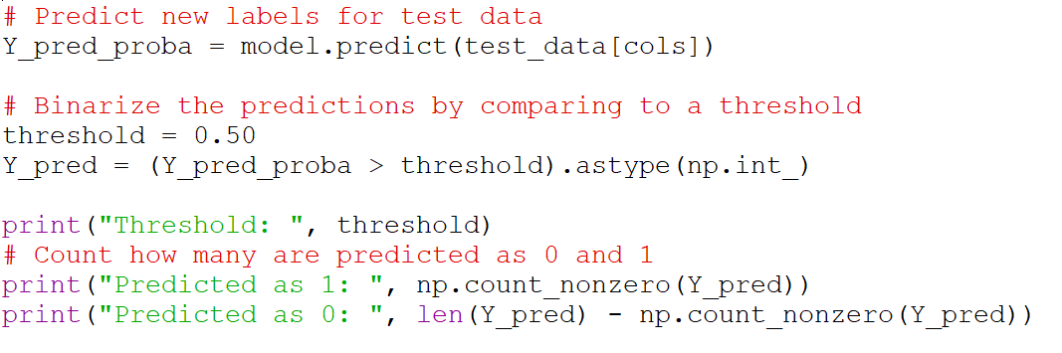
Binary Classification with Linear Regression
The prediction probabilities need to be compared to a threshold to decide if they are going to be classified as 1 or 0
For most problems, a threshold of 0.5 makes sense:
See CreditDefault_LinearRegression_2.py

Slide 16
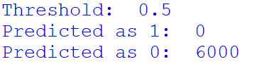
Binary Classification with Linear Regression
With a threshold of 0.5:
No predictions of 1 were made!
This situation can happen in class-imbalanced problems like this one
If the classes are not well separated
And the model is underfitted
What to do?
Weight-balance the outputs
Reduce the threshold
Add more data
Improve the model

Slide 17
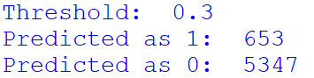
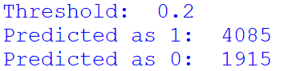
Binary Classification with Linear Regression
Let’s try lowering the threshold:
The more we lower the threshold, the more 1s we will predict
What is the correct threshold to use?
What is the tradeoff?

Slide 18

The Confusion Matrix
Provides a complete picture of classification results
 |  | Predicted Label
 |  | False | True
Correct Label | False | True Negatives (TN) | False Positives (FP)
 | True | False Negatives (FN) | True Positives (TP)

Slide 19
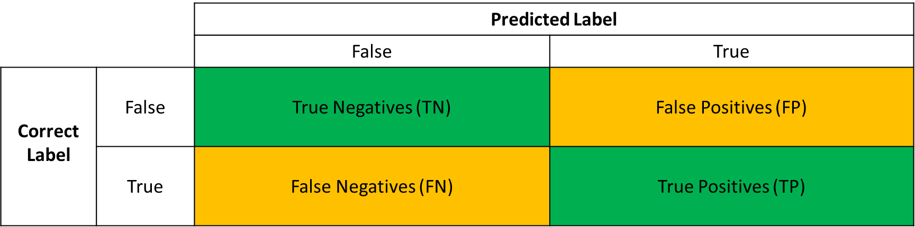
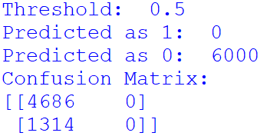
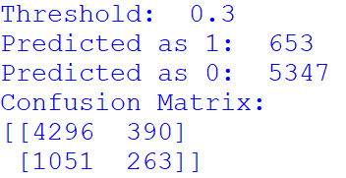
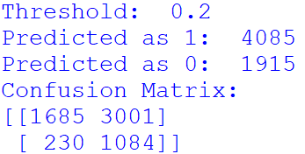
The Confusion Matrix
In scikit-learn:
See CreditDefault_LinearRegression_2.py

Slide 20
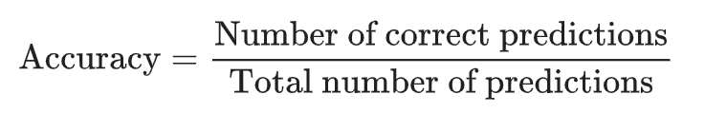
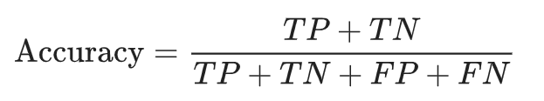
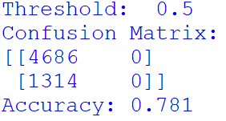
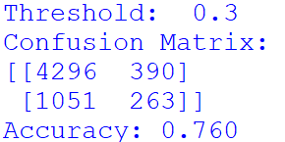
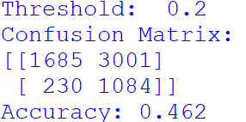
Accuracy
Can be misleading in class-imbalanced cases (naive behavior)
See CreditDefault_LinearRegression_2.py

Slide 21
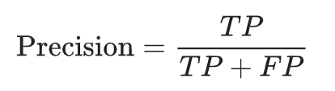
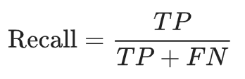
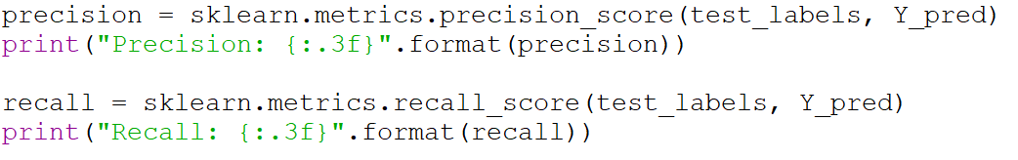
Precision & Recall
Precision:
Out of all the positive predictions, how many are actually correct?
Recall:
Out of all the actual positives, how many did we correctly predict?

Slide 22
Practice 2
Load the credit default dataset pickle file (credit_card_default_dataset.pickle)
Train a linear prediction model against all the available features
Compute the prediction probabilities
For each of the following thresholds: 0.35, 0.30, 0.25, 0.20, 0.15, 0.10
Create a vector of binary predictions
Compute the confusion matrix
Compute the accuracy
Compute the precision
Compute the recall

Slide 23
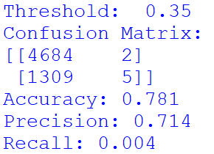
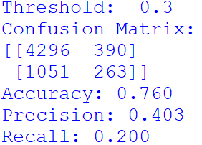
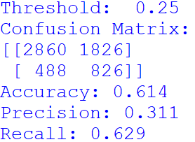
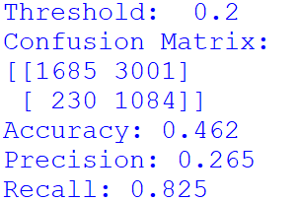
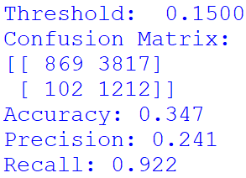
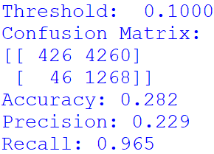
Practice 2
The classification threshold will trade-off precision vs. recall

Slide 24
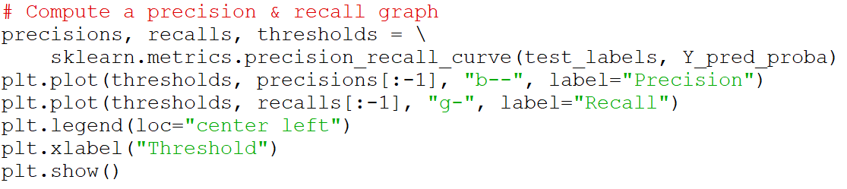
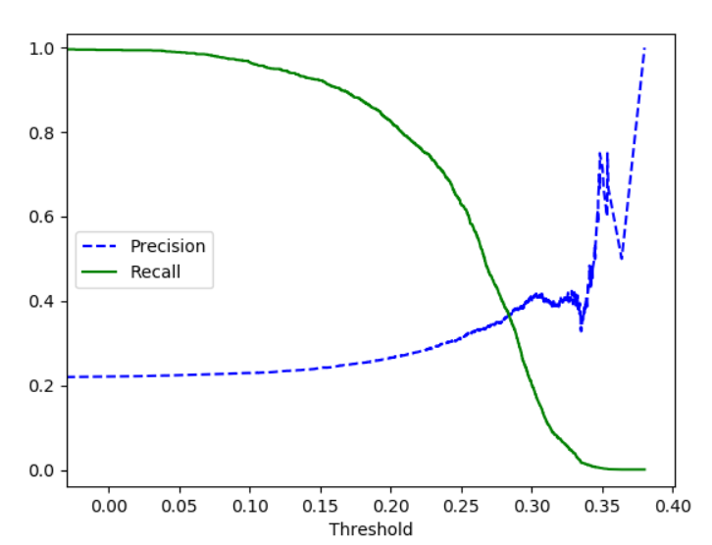
Precision – Recall Graph
We can clearly see the tradeoff between precision & recall
Ideally there would be an area with both good precision and good recall
This is not the case
We can choose a threshold that maximizes both
Or give one of them more importance
See CreditDefault_LinearRegression_3.py

Slide 25
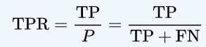
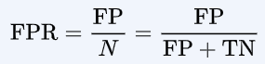
TPR vs. FPR
True Positive Rate TPR
Same as Recall
False Positive Rate FPR
Fall-out rate
As we lower the threshold we increase TPR
A good classifier does this without increasing FPR too much

Slide 26
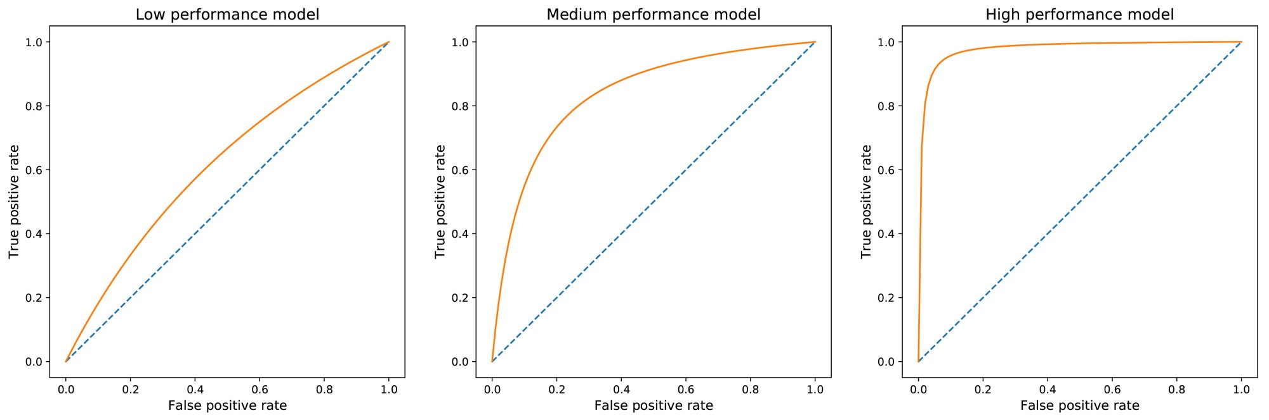
Receiver Operating Characteristic
Comparison of true positive rate against false positive rate
The area under the curve (AUC) provides a measure of classifier quality

Slide 27
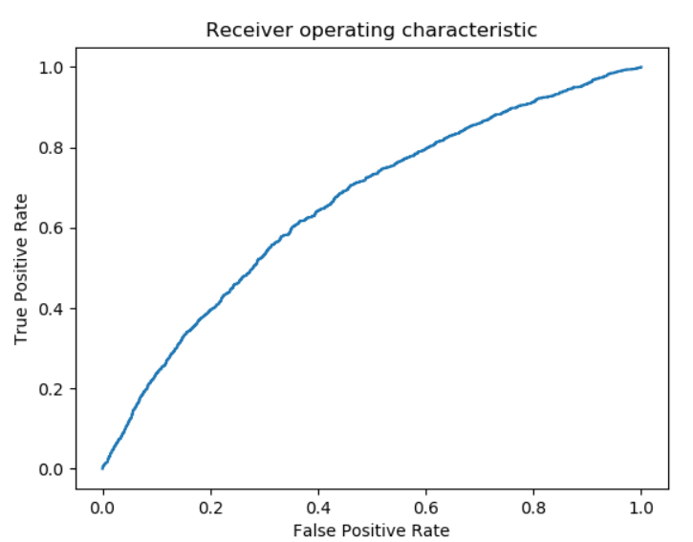
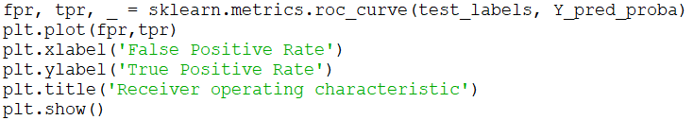
Receiver Operating Characteristic (ROC)
ROC computation:
AUC computation:
See CreditDefault_LinearRegression_3.py

Slide 28
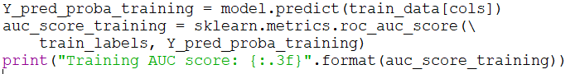
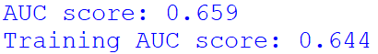
Overfitting / Underfitting
As before, we compute the quality metrics against the test data and the training data
The scores are similar, which suggests the model is underfitting the data
See CreditDefault_LinearRegression_3.py

Slide 29
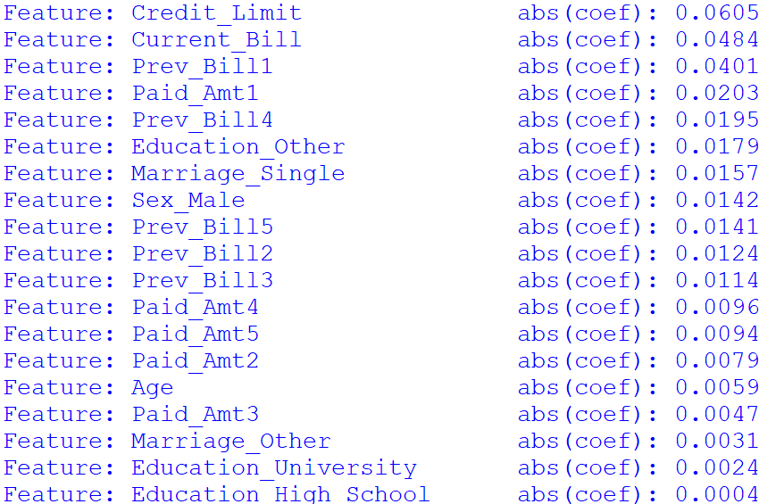
Feature Importance
As before, we use the absolute value of the coefficients to infer feature importance
See CreditDefault_LinearRegression_4.py

Slide 30
Optional HW Problem
Implement linear regression using weight-balanced class values
Scale the outputs in a ratio inversely proportional to the ratio of classes
Compute a Precision & Recall graph
How does it look, compared to the previous case?
Compute the ROC and AUC
Did it improve?
Is weight-balancing the classes helpful?

Slide 31
Logistic Regression

Slide 32
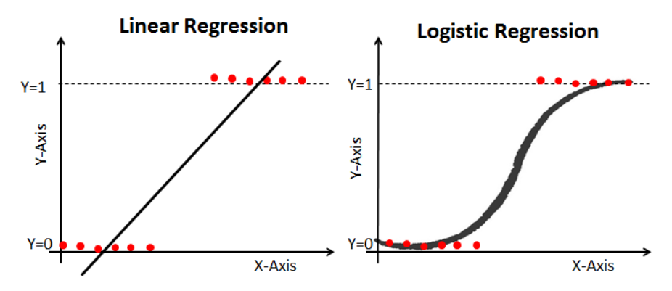
Motivation for Logistic Regression
For classification problems, a linear model doesn’t quite fit what we want
We want something that produces an output close to 0 or to 1, but not in the middle (red dots below)
Logistic regression uses an S-shaped function that is closer to what we want

Slide 33


The Logistic Function
$f\left(x\right)= \frac{1}{1+e^{−x}}$
Maps any range of x to [0, 1]
Related to the hyperbolic tangent
Sometimes is called the sigmoid function
But sigmoid really refers to any S-shaped function

Slide 34


Logistic Regression
$$y=\frac{1}{1+e^{−(θ_{0}+θ_{1}x_{1}+ θ_{2}x_{2}+…+ θ_{n}x_{n})}}$$
Starts with a linear combination of the inputs
Adds a logistic function as the “activation” function

Slide 35


Training a Logistic Regressor
There is no closed-form solution
The response is non-linear
Need to use iterative approximation methods
Minimize a cost function
Should be monotonic, so there is a global minimum
Cost function for logistic regression:

Slide 36


Gradient Descent
Iterative algorithm to minimize a cost function J(Θ)
Adjusts each parameter Θ_{j} by an amount that is proportional to the derivative of the cost function J(Θ) w.r.t. the parameter Θ_{j}
α is the learning rate
The derivative can be analytical or estimated from differences
Takes steps in the direction of the steepest slope

Slide 37

Logistic Regression in Scikit-Learn
There are multiple solvers available: newton-cg, sag, saga, liblinear
All are variants of gradient descent
See CreditDefault_LogisticRegression_1.py

Slide 38

Logistic Regression in Scikit-Learn
See CreditDefault_LogisticRegression_1.py

Slide 39
Practice 3
Train a logistic regression model for the credit default dataset (credit_card_default_dataset.pickle)
Compute and plot a Precision & Recall plot
Compute and plot a Receiver Operating Characteristic (ROC) plot
Compute the AUC score for the test data
Compute the AUC score for the training data

Slide 40



Logistic Regression in Scikit-Learn

Slide 41
Optional HW Problem
Extract a sorted list of feature importances, based on the logistic regression coefficients
Are they the same as for linear regression?

Slide 42

Break
Back at

Slide 43
Support Vector Machines

Slide 44

Support Vector Machines
Tries to separate classes by a decision boundary
Fits a decision boundary function that produces maximum margin
In overlapping classes, the objective is to minimize violations of the boundary
Linear SVM uses linear boundary function
One coefficient for every input feature

Slide 45


Linear SVM in Scikit-Learn
See CreditDefault_LinearSVM_1.py

Slide 46



Linear SVM in Scikit-Learn
See CreditDefault_LinearSVM_2.py

Slide 47

Polynomial SVM
We can have higher-order decision boundary functions
Equivalent to having polynomial derived features

Slide 48
K-Nearest Neighbors

Slide 49

K-Nearest Neighbors Classifier
An instance-based classifier
Compares each test point against the K nearest points
Distance is Euclidean with respect to each feature
Feature scales should be standardized
Uses majority vote
Better for problems with few features

Slide 50




K-Nearest Neighbors in Scikit-Learn
The optimal number of neighbors is problem specific
See CreditDefault_kNN_1.py

Slide 51
Decision Trees & Random Forests

Slide 52

Decision Trees
Uses a hierarchical set of decisions based on one feature at a time
The most discriminating feature is used first
Once this decision has been made, it may use a second feature to further discriminate
This creates a decision tree
Not all branches need to use all features

Slide 53

Training Decision Trees
The CART algorithm
Divides the set into two using the feature that discriminates best
Measures the “impurity” of each subset
If too impure, subdivide further using another feature

Slide 54

Decision Trees in Scikit-Learn
The prediction probabilities are derived from the impurity of the nodes
See CreditDefault_DecTree_1.py

Slide 55



Decision Trees in Scikit-Learn
What happened?
See CreditDefault_DecTree_1.py

Slide 56
Preventing Overfitting in Decision Trees
We need to prevent the tree from splitting into very small leaves
Use the parameter min_samples_leaf
There are other ways
Let’s try with min_samples_leaf = 100

Slide 57



Decision Trees in Scikit-Learn
Much better
What is an optimal value of min_samples_leaf?
See CreditDefault_DecTree_1.py

Slide 58
Practice 4
Train a decision tree classifier for the credit default dataset (credit_card_default_dataset.pickle)
Try different values of the parameter min_samples_leaf. For each:
Compute the AUC score for the test data
Compute the AUC score for the training data
What is the best value of min_samples_leaf that you could find?

Slide 59

Practice 4

Slide 60

Viewing the Decision Tree
This saves a .dot file, which is a textual graph representation
To visualize it, you can use a web service (like http://www.webgraphviz.com/)
See CreditDefault_DecTree_4.py

Slide 61

Sensitivity to Datasets
Decision trees are known to be very sensitive to the training data set
Makes them unpredictable
For example, if we try training with different subsets of the training data:
Results vary significantly
See CreditDefault_DecTree_3.py

Slide 62


Feature Importance
Beware that feature importances are also sensitive to input data
See CreditDefault_DecTree_5.py

Slide 63
Random Forests

Slide 64

Random Forests
Trains many decision tree classifiers on random subsets of the data
Aggregates the predictions of each classifier by counting votes
Its an ensemble method
Makes the aggregate result more stable

Slide 65

Random Forests in Scikit-Learn
Using multiple estimators provides more repeatable results
Also tends to improve the overall results
Up to a certain point
Can be slow
See CreditDefault_RandForest_1.py

Slide 66
Practice 5
Train a random forest classifier for the credit default dataset (credit_card_default_dataset.pickle)
Try different values for the parameter n_estimators. For each:
Compute the AUC score for the test data
Run multiple times. Are your results repeatable?
Pick a value that provides consistent results
Once you are satisfied with the number of estimators, try different values of min_samples_leaf
What is the best AUC score you could get?

Slide 67

Random Forests in Scikit-Learn
With n_estimators = 1

Slide 68

Random Forests in Scikit-Learn
With n_estimators = 5

Slide 69

Random Forests in Scikit-Learn
With n_estimators = 10

Slide 70

Random Forests in Scikit-Learn
With n_estimators = 50

Slide 71

Random Forests in Scikit-Learn
With n_estimators = 100

Slide 72

Random Forests in Scikit-Learn
With n_estimators = 500
Not worth it
Little improvement
Very slow
Will stay with 100

Slide 73
Re-visit min_samples_leaf
min_samples_leaf | Test AUC sore | Train AUC score
350 | .725 | .731
300 | .730 | .736
200 | .732 | .748
100 | .737 | .772
50 | .740 | .803
20 | .742 | .870
15 | .738 | .894
10 | .739 | .928

Slide 74



Random Forests in Scikit-Learn
With n_estimators = 100, min_samples_leaf=20
See CreditDefault_RandForest_2.py

Slide 75

Feature Importances from Random Forests
See CreditDefault_RandForest_2.py

Slide 76
Optional HW Problem
Use GridSearchCV in scikit-learn, as a way to automatically search for the best tuning parameters in your random forest.

Slide 77
Ensemble Classifiers

Slide 78

Ensemble Classifiers
We can combine multiple classifiers and take majority vote
Allows us to combine different approaches

Slide 79
Ensemble Classifiers
Let’s combine the following classifiers:
Logistic regression:
K-Nearest neighbors
Random forest

Slide 80

See CreditDefault_Ensemble_1.py

Slide 81

Ensemble Classifiers
Result:
In this case the result is worse
But this is generally a good technique that can improve results
See CreditDefault_Ensemble_1.py

Slide 82
Optional HW Problem
Consider pruning some features that may not be adding independent information
Try removing Prev_Bill5 and Paid_Amt5
Re-train some of your classifiers (logistic, random forest)
Did results degrade, stay the same, or improve?
Try removing more features and see what happens

Slide 83
Thank you

